Slide 1
Essential Probability and Statistics for Big Data
Jeff Chuang (with thanks to Joel Graber)
jeff.chuang@jax.org

Slide 2
Learning Objectives
Descriptive Statistics
Distributions and p-values
Bayesian Inference
Multiple Hypothesis Testing
Introduction to Data Mining

Slide 3
Descriptive Statistics
With acknowledgement to Jacques van Helden for many of the images

Slide 4
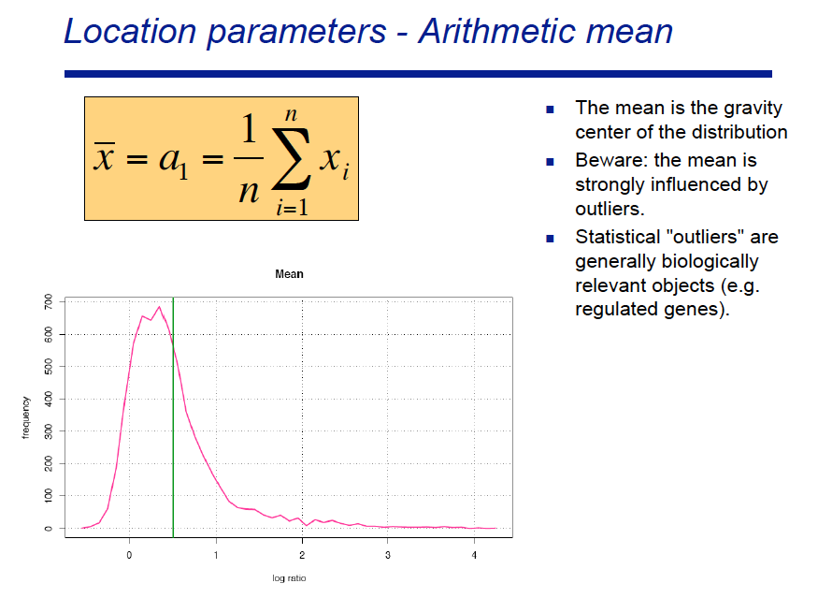

Slide 5
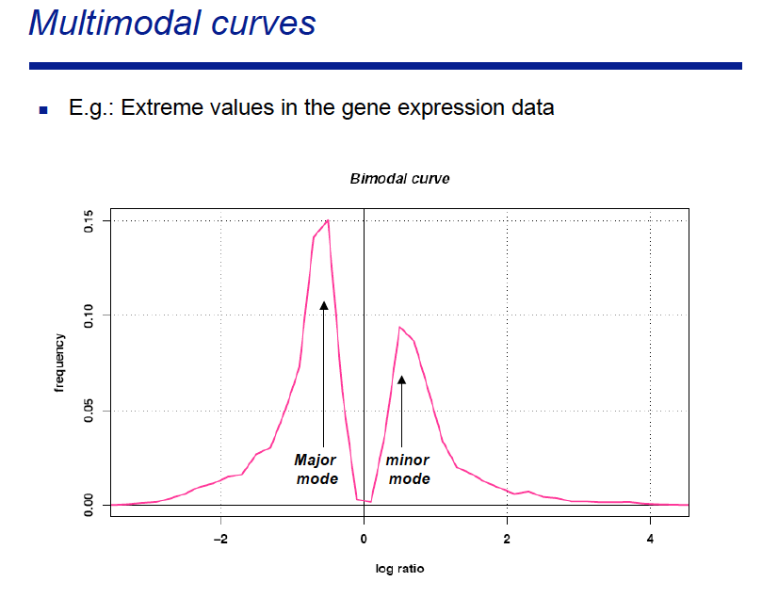

Slide 6
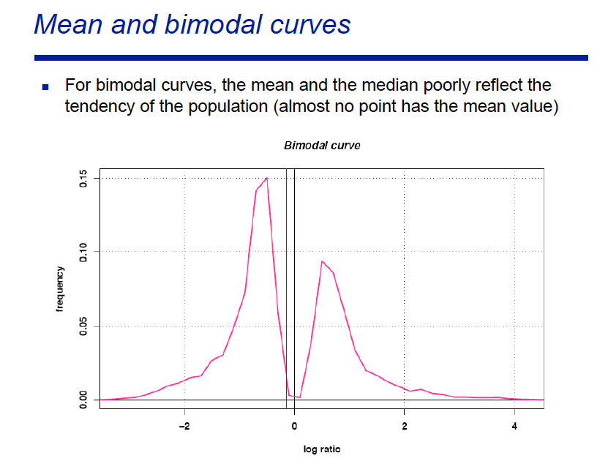

Slide 7
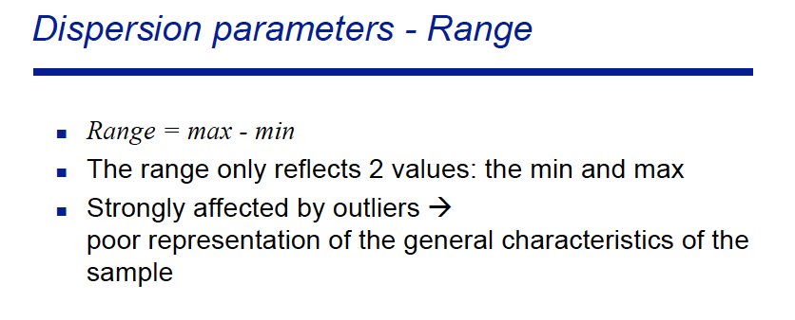

Slide 8
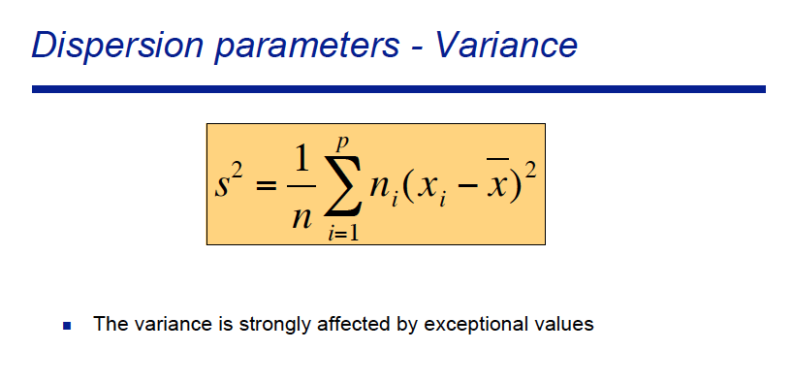

Slide 9
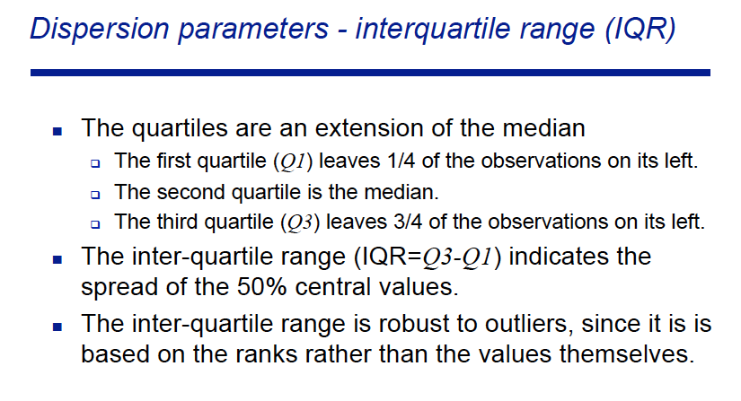

Slide 10
Normally distributed variates and Z-scores
The Central Limit Theorem states that any sum of random variables, regardless of their underlying distribution, will tend towards a normal distribution
A normal distribution can be described by two parameters, the mean (μ) and standard deviation (σ)
Normally distributed scores are converted to Z-scores via:

Slide 11
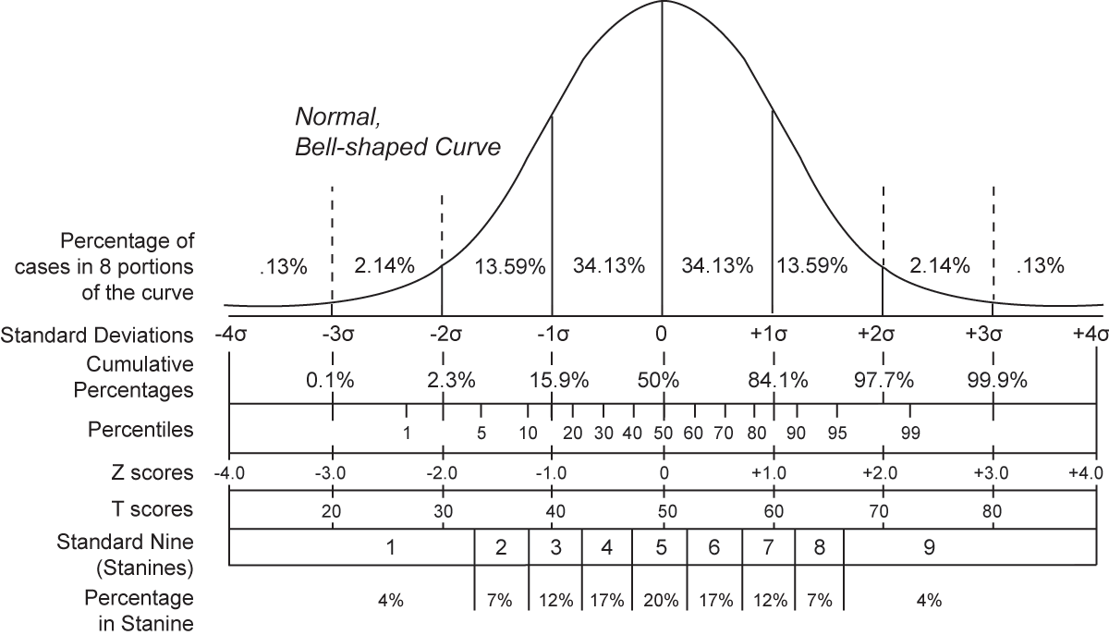
Statistical significance: Z-scores and cumulative standard normal distributions
A Z-score tests against the null hypothesis that a measurement arises as random fluctuation of a normally distributed variable
Probability is determined from the area under the standard normal curve

Slide 12
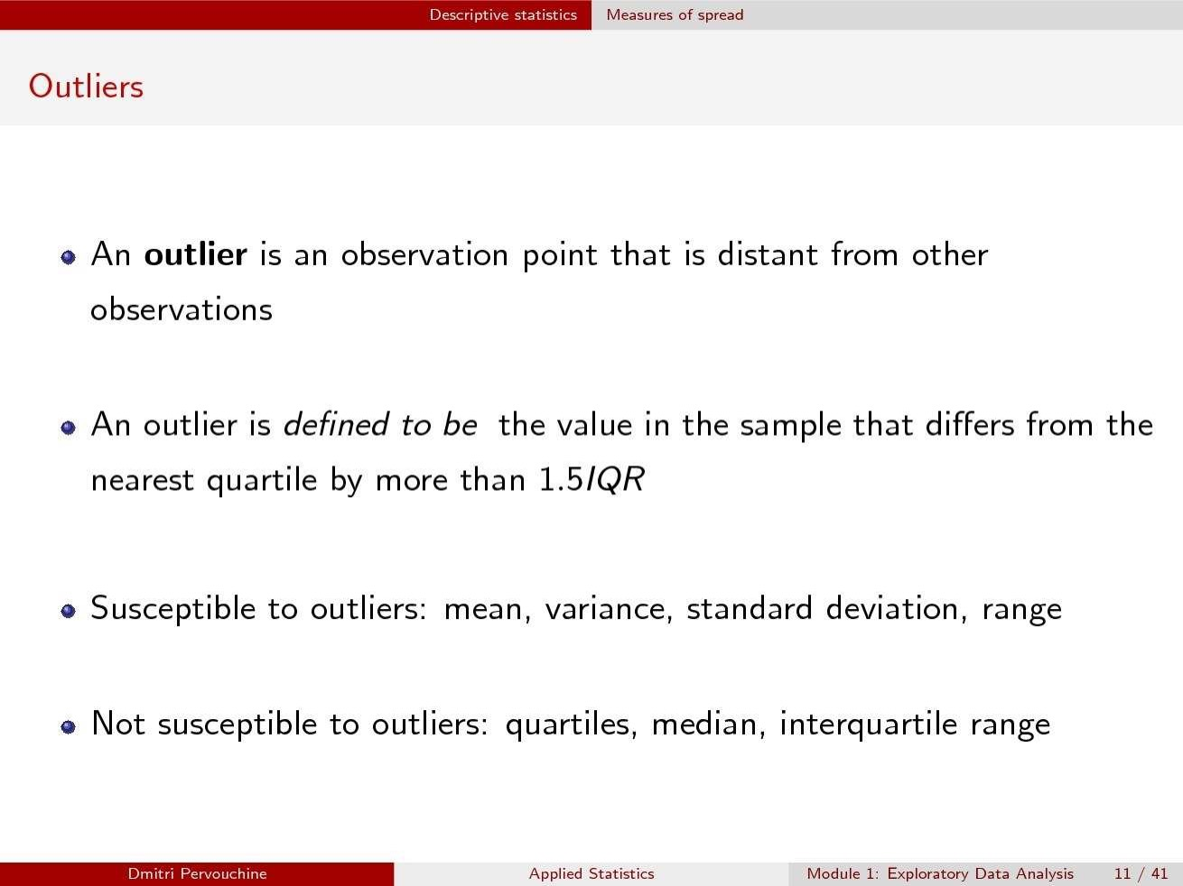

Slide 13
Things to remember
Summary variables may not accurately reflect the distribution
Biological systems are frequently noisy-- be wary of outliers and their impact on summary statistics
Mean and variance are interpretable only if your data can be reasonably fit to a normal distribution

Slide 14
Distributions

Slide 15
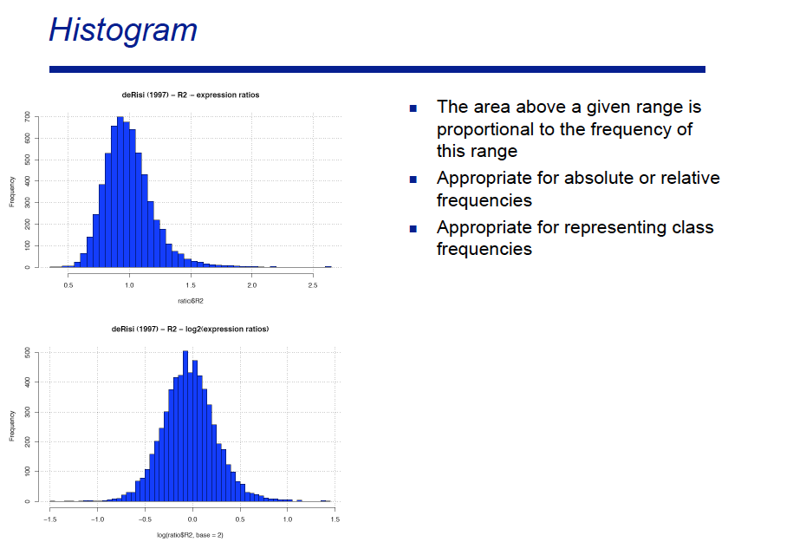

Slide 16
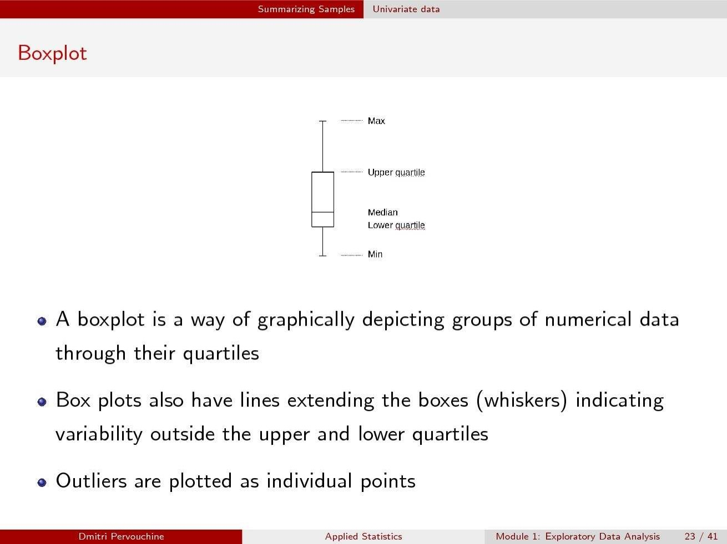

Slide 17
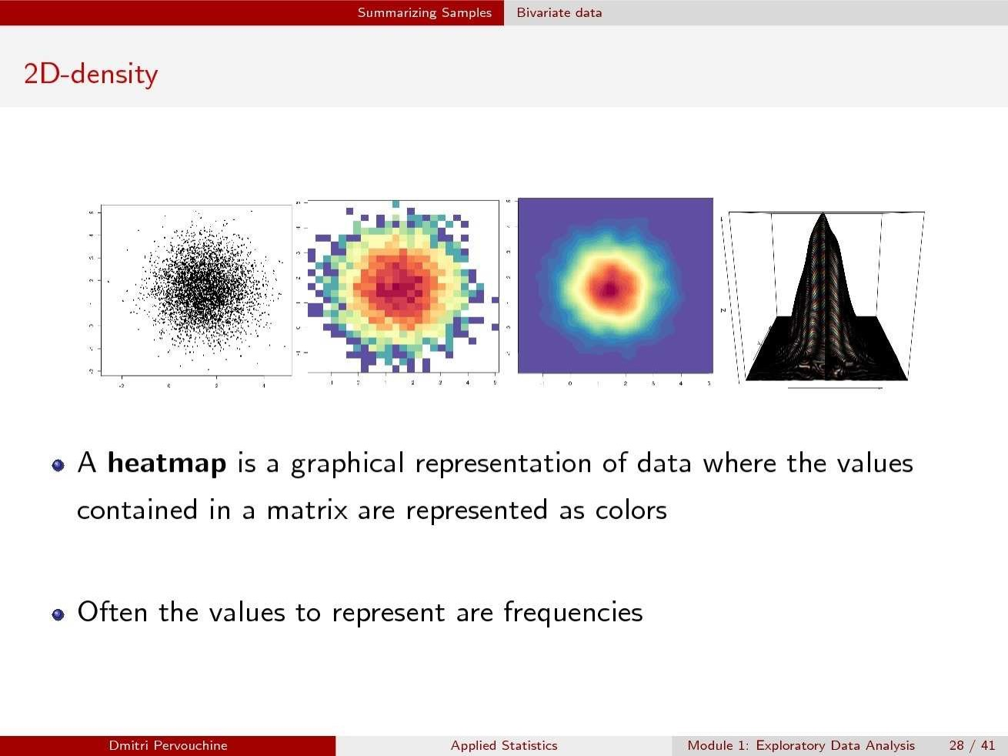

Slide 18
http://blog.cloudera.com/blog/2015/12/common-probability-distributions-the-data-scientists-crib-sheet/

Slide 19
Why do these distributions matter?
We are frequently testing questions like:
Are these genes differentially expressed?
Alternatively stated:
What is the likelihood of observing these counts under the assumption that they came from the same expression distribution?

Slide 20
Gene expression fits the negative binomial distribution
https://bioramble.wordpress.com/2016/01/30/why-sequencing-data-is-modeled-as-negative-binomial/

Slide 21
Poisson and Negative Binomial can result in very different “p-values”

Slide 22
Model Evaluation

Slide 23
Assessing performance: Sensitivity and Specificity
Testing of predictions is performed on sequences where the answer is known
Sensitivity is the fraction of known elements correctly predicted
“Am I finding the things that I’m supposed to find?”
Specificity is the fraction of predict elements that correspond to true elements
“What fraction of my predictions are true?”
In general, increasing one decreases the other

Slide 24
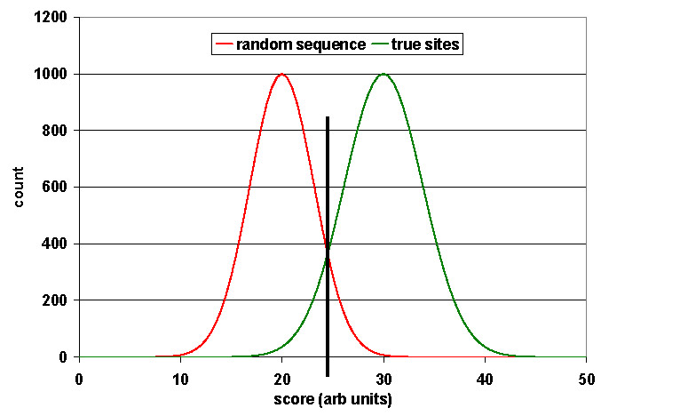
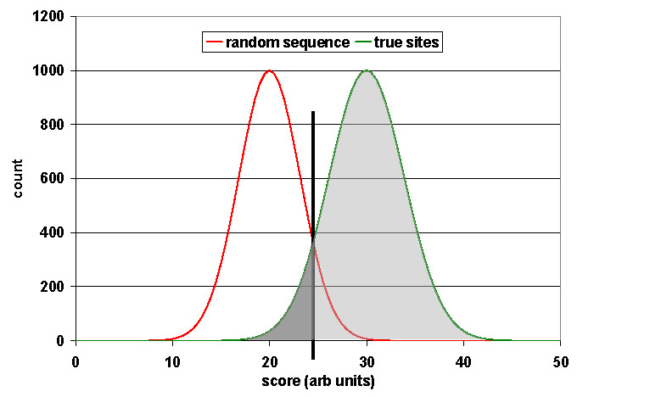
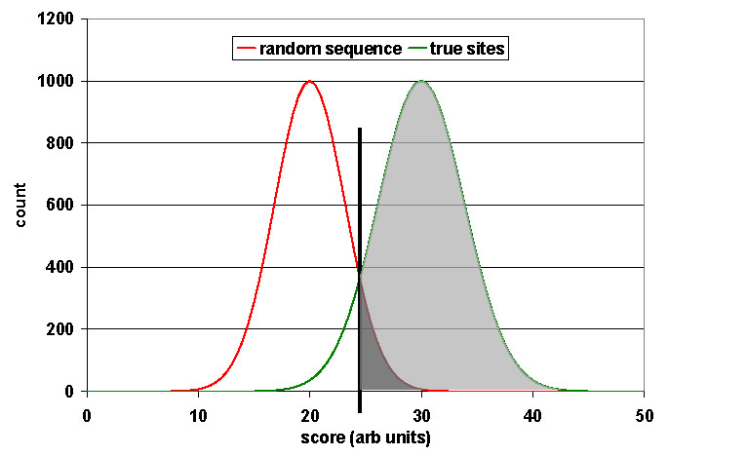
Graphic View of Specificity and Sensitivity

Slide 25
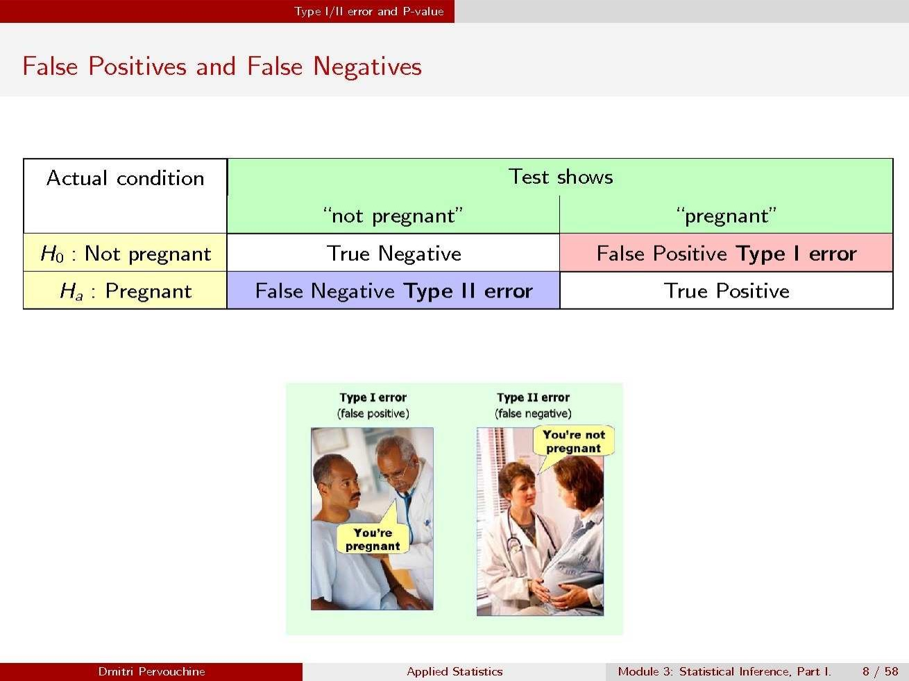

Slide 26
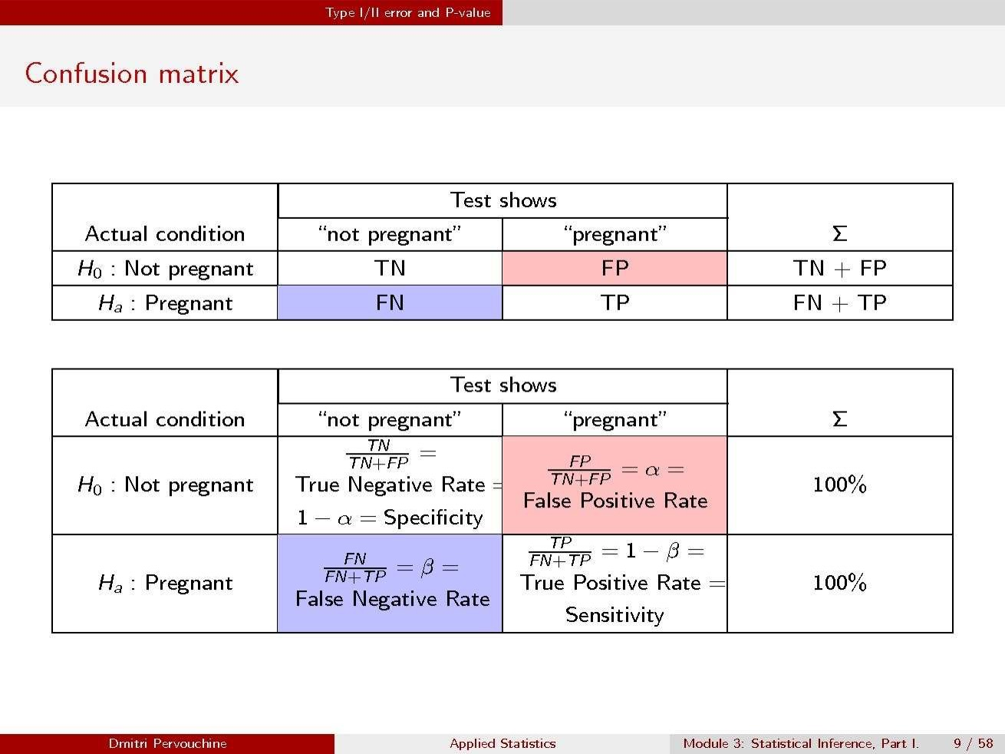

Slide 27
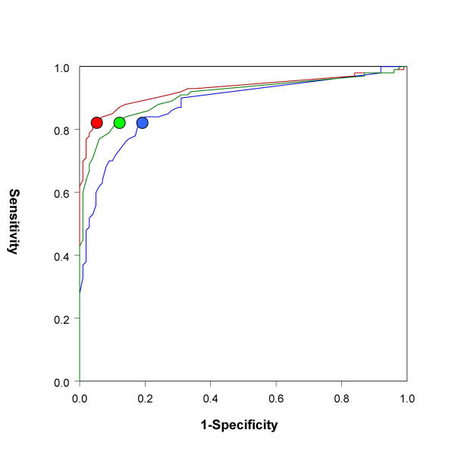
Quantifying the tradeoff: Receiver-Operator Curve analysis
Precision-recall curves provide similar evaluations while also adjusting for data imbalances

Slide 28
Basic Bayesian Statistics

Slide 29
Inverting the probability problem: statistical inference
Standard analysis:
Given a model, compute the probability of observing one or more “events”
Statistical inference:
Given two or more competing models, identify the model most probable to have generated the observed data

Slide 30
Bayesian Statistics: Statistical Inference
Bayes’ Rule
M: the model, D: data or evidence
likelihood
prior
posterior
marginal

Slide 31
Basic Bayesian Statistics
Bayes’ Rule is at the heart of much predictive software
Calculating marginal probabilities is complex and often computationally prohibitive
In the simplest example, we can just compare a regulatory model vs. random and reduce it to a log-odds ratio

Slide 32
Multiple Hypothesis testing

Slide 33
Multiple Hypothesis testing
Modern comp bio frequently involves simultaneous assessment of many hypotheses:
Are any regions of the genome amplified? (10⁶-10⁹)
Do any transcripts have unusual expression? (10⁴-10⁵)
Do any motifs recur? (4⁴ - 4¹⁰)
Low probability values appear simply because many things are tested
We must correct for this in assessing significance

Slide 34
Types of multiple hypothesis correction
Bonferroni correction
Multiply lowest probability obtained by the number of tests
Very conservative estimate
Family-Wise Error Rate (FWER)
Determine the best probability obtained under a given model
Find all measurements better than this value in true set
Controls for any value <= p_{obs} under the null hypothesis
False Discovery Rate (FDR, typically denoted q)
Essentially a scaled Bonferroni
Sort probabilities obtained
Multiply by N/rank(r)
Controls for the probability of obtaining the r^{th} value <= p_{obs} under the null

Slide 35
An example FDR correction
p-values
0.340
0.039
0.005
0.912
0.405
0.425
0.241
0.487
0.027
0.429
0.699
0.020
0.172
0.483
0.755
0.521
0.441
0.014
0.796
0.329
0.005
0.014
0.020
0.027
0.039
0.172
0.241
0.329
0.340
0.405
0.425
0.429
0.441
0.483
0.487
0.521
0.699
0.755
0.796
0.912
0.104
0.138
0.134
0.137
0.157
0.573
0.688
0.822
0.757
0.811
0.772
0.716
0.679
0.691
0.650
0.651
0.823
0.839
0.838
0.912
0.104
0.134
0.134
0.137
0.157
0.573
0.650
0.650
0.650
0.650
0.650
0.650
0.650
0.650
0.650
0.651
0.823
0.838
0.838
0.912
Take
minimum
value
for any
greater
rank
Multiply
each
by
N/rank
sort

Slide 36
Introductory Data Mining

Slide 37
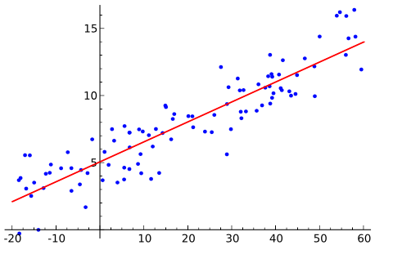
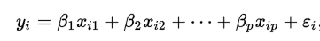
Regression
Modeling the relationship between a dependent variable y and one or more explanatory variables x
Notes:
By Sewaqu - Own work, Public Domain, https://commons.wikimedia.org/w/index.php?curid=11967659

Slide 38
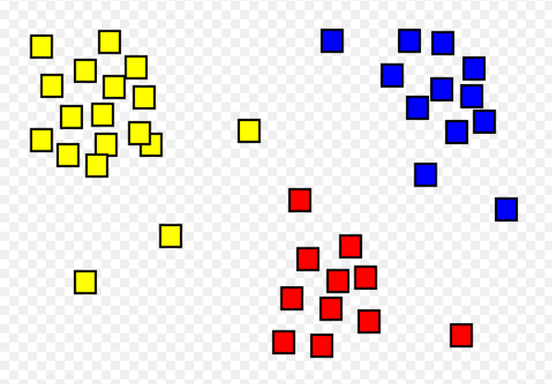
Clustering
Clustering: grouping sets of objects by similarity.
Common approaches include jierarchical clustering (e.g. UPGMA), K-means, and density-based clustering

Slide 39

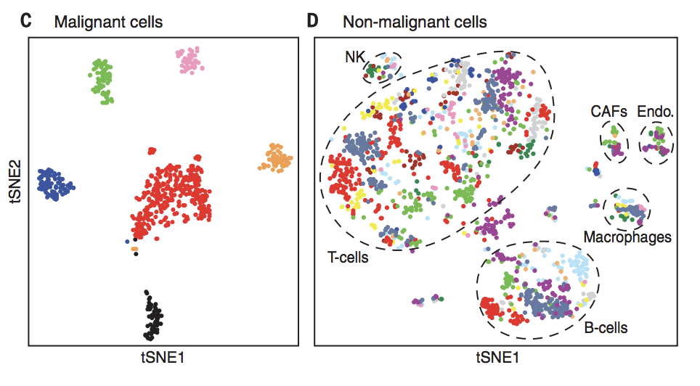
Example: t-SNE is a nonlinear dimensionality reduction technique well-suited for embedding high-dimensional data for visualization in a low-dimensional space of two or three dimensions.

Slide 40
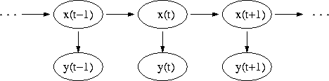
Advanced: Hidden Markov Models
Markov models are a simple Bayesian network in which states are probabilistically dependent on their predecessors
Hidden state
(which type of coin)
In Hidden Markov Models, the observed variable depends on the hidden state. Common as an introductory Bayesian network in sequence analysis.
Observed variable (H or T)
Notes:
Thanks to GC Yuan

Slide 41

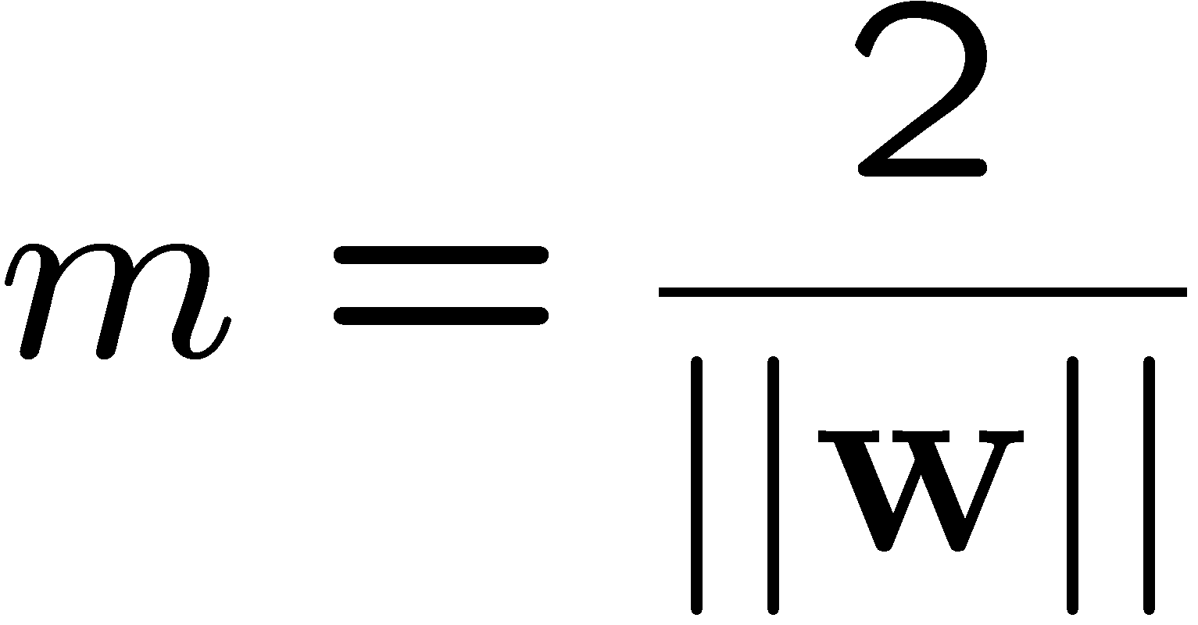
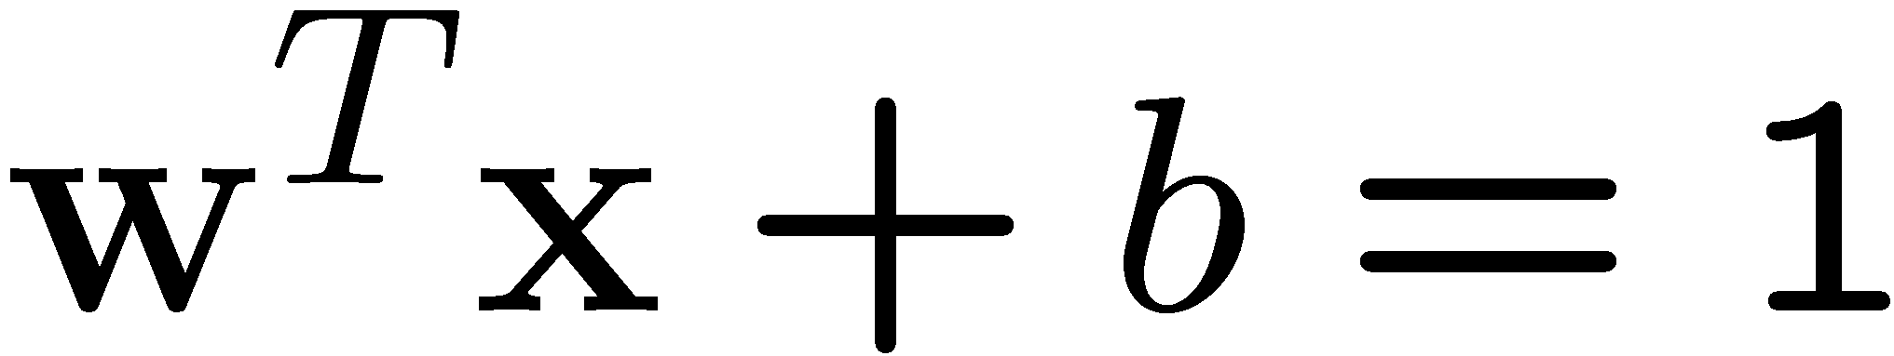
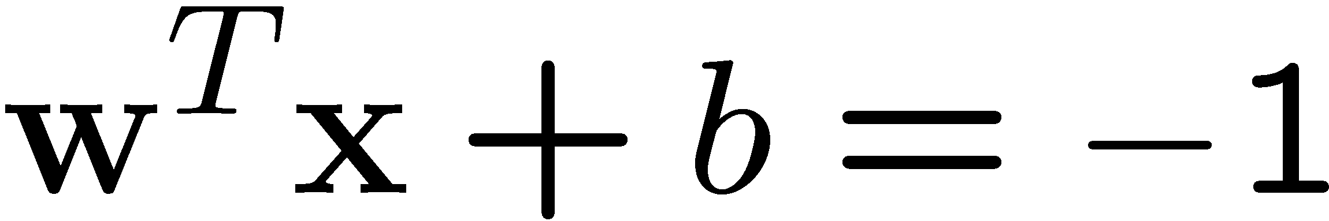
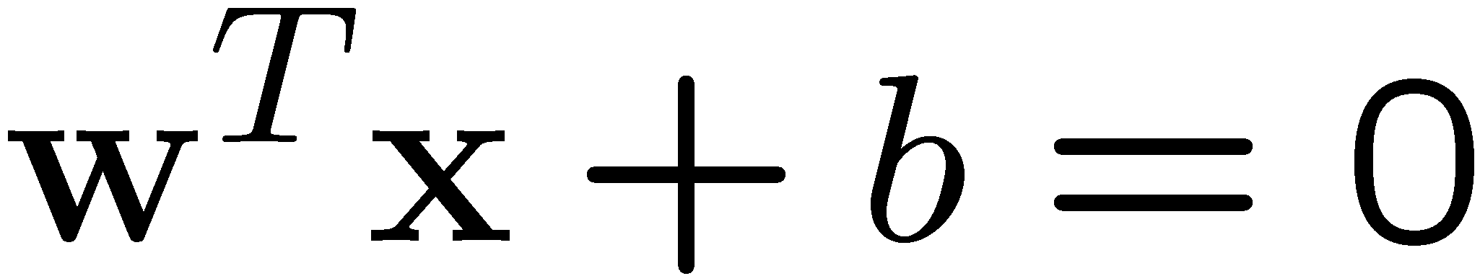
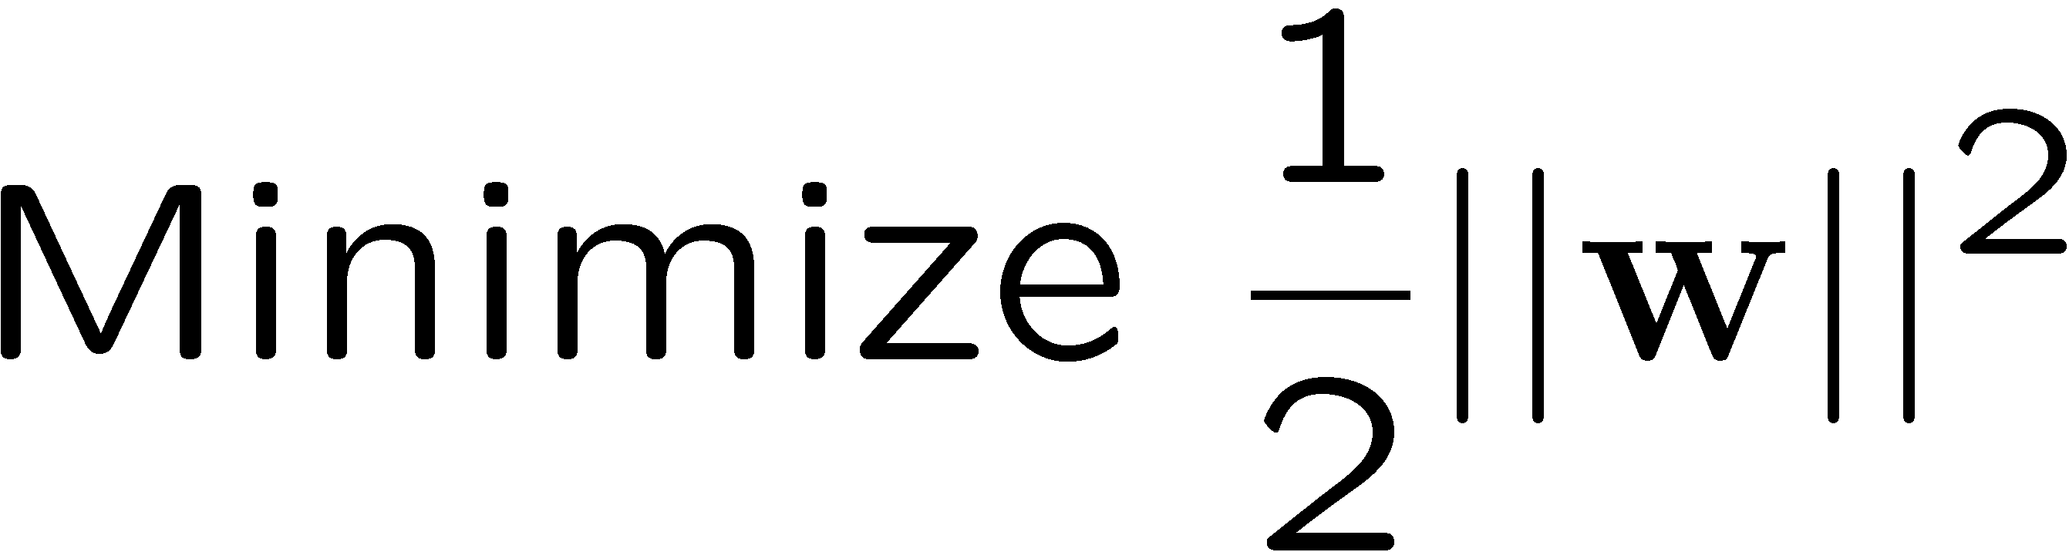
Advanced: Support Vector Machines
A binary classifier suitable for high-dimensional data
Class 2
m
Class 1
Notes:
Thanks to Martin Law

Slide 42
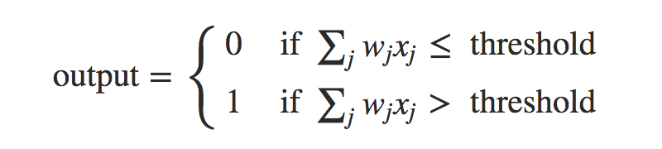
Advanced: Neural Networks
Input layer
Weights {w}
Output layer
Training the neural network means finding the weights {w} which best fit the training data
neuralnetworksanddeeplearning.com

Slide 43
Neural network example
Input layer
Output layer
Today’s temperature
w_{temp}
Tomorrow
rain / no rain
w_{humid}
Today’s humidity
Optimal w_{temp} and w_{humid} should be non-zero.
Optimal w_{day} should be zero.
Today’s day of the week
w_{day}
neuralnetworksanddeeplearning.com

Slide 44
Adding a hidden layer improves complexity of input-output fitting
Input layer
Hidden layer
Output layer
neuralnetworksanddeeplearning.com
The number of nodes in each layer is flexible. Choice of the number of nodes may affect accuracy of predictions.

Slide 45
Multilayer Neural Network
Hidden layer
Hidden layer
Input layer
Output layer
neuralnetworksanddeeplearning.com
The number of hidden layers can be adjusted. ”Deep” networks may use 50-100 hidden layers.

Slide 46
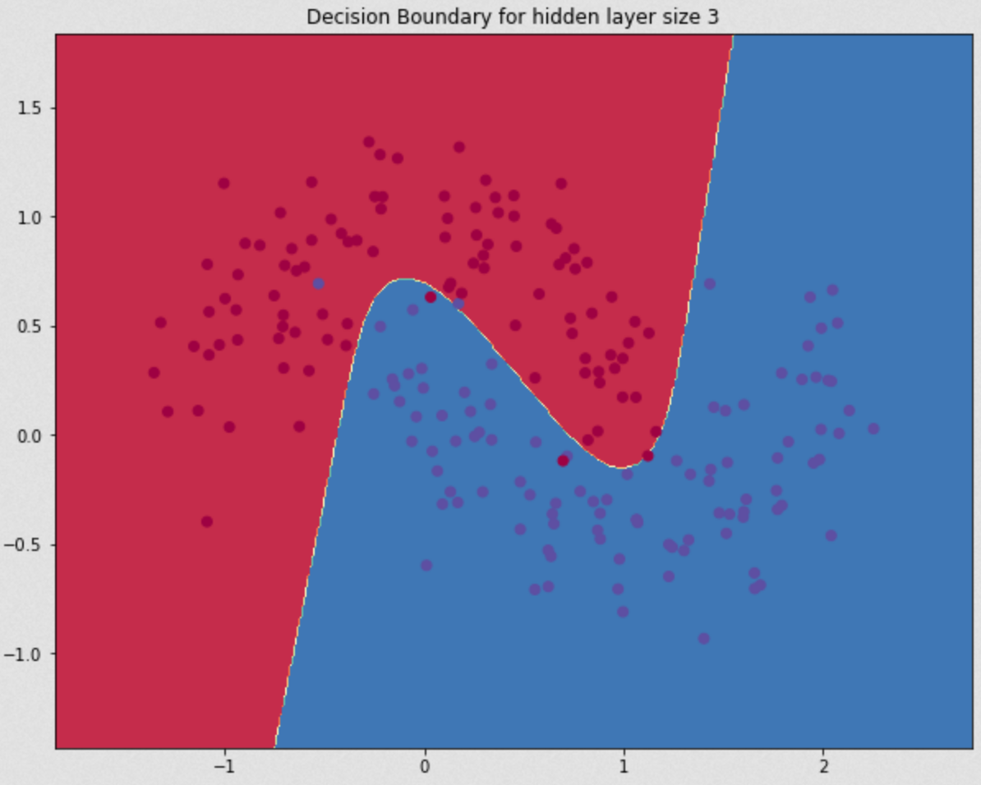
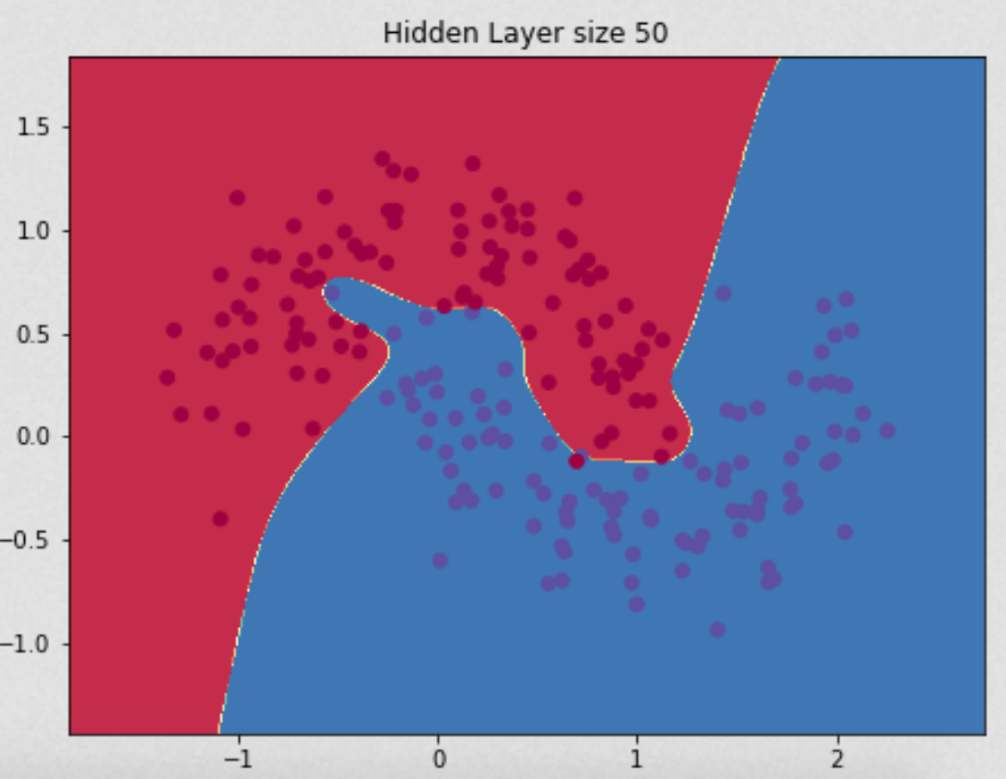
Common ways to apply data mining methods
R, Python notebooks Common software libraries: Inception, Keras, sklearn

